Slide 1



Regional Office RR Nagar
Presentation on Higher Pension

Slide 2



CONTENT
01
WHAT IS THE EPF HIGHER PENSION SCHEME?
02
HIGHER PENSION CONTRIBUTION UNDER EPS
03
HIGHER PENSION SCHEME APPLICATION LAST DATE
04
EPF HIGHER PENSION ELIGIBILITY
05
EPF HIGHER PENSION OPTION FORM
06
HOW TO APPLY FOR A HIGHER PENSION IN EPF?
07
HOW TO APPLY FOR A JOINT OPTION ONLINE PENSION FORM IN EPF?
08
EPFO GUIDELINES FOR HIGHER PENSION
09
EPF HIGHER PENSION CALCULATION
10
FREQUENTLY ASKED QUESTIONS

Slide 3

What is the EPF higher pension scheme?
In 1995, the Government introduced a pension scheme under Section 6A of the EPF Act. The Employees Pension Scheme, 1995 (EPS-95) provided that the employer’s contribution of 8.33% should be towards the pension scheme. The EPS-95 capped the maximum monthly pension at Rs.5,000 or Rs.6,000. Thus, employers had to contribute 8.33% of Rs.5,000, which was later raised to Rs.6,500, towards the pension scheme.
In March 1996, a provision was added to para 11(3) of the EPS-95, giving the employer and employee an option to contribute 8.33% of actual salary (above the cap of Rs.5,000 or Rs.6,500) to the EPS. Such a higher salary would be considered a pensionable salary. However, the EPFO gave six months for the employees to file a joint option form for higher pension contributions to the EPS.
The government amended the EPS-95 scheme effective from 01/09/2014. It increased the maximum pensionable salary to Rs.15,000. It also omitted the provision to para 11(3), i.e. exercise of the option by the employer and employee to contribute EPS on a higher salary amount.
Thus, employers would make an EPS contribution of 8.33% on a maximum of Rs.15,000 for the employees joining the EPF scheme after 01/09/2014, even when they draw a higher salary.
However, the employees who were part of EPS-95 or joined before 01/09/2014 could contribute 8.33% to EPS on the actual salary as against the cap of Rs.15,000 if they filed a new joint option with the EPFO within six months, i.e. 28/02/2015.

Slide 4
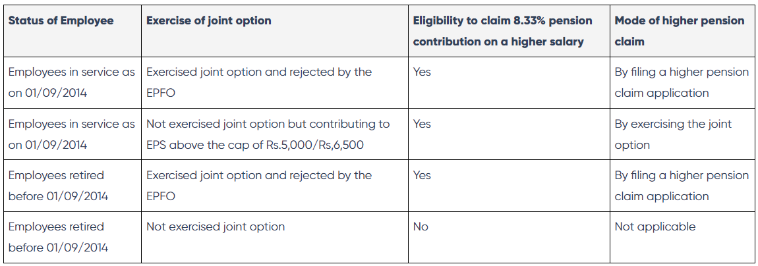
Higher pension contribution under EPS
There were issues after the 2014 amendment regarding pension contributions on higher salaries. Many employees stated that they did know about the exercise of the joint option for contributing pension on the higher salary amount. The EPFO rejected the joint option filed by many employees. Employers contributed 8.33% of pension on employees’ actual salaries without filing the joint option, but the pensionable salary was taken as Rs.15,000 for pension calculation.
Thus, many employees filed cases in High Courts for receiving higher pensions based on the contributions made on actual salary amounts. The Supreme Court took up this matter. The summary of the Supreme Court decision is as follows:

Slide 5
Higher pension contribution under EPS
The Supreme Court provided that employees who were member of the EPS before 01/09/2014 but have not exercised the joint option can exercise it within 03/05/2023. The EPFO further extended the due date up to 26/06/2023. For such employees, a higher EPS contribution will be calculated from the date of their joining.
For example:
  Mr. ‘X’ became a member of the EPF in 1998.
  He has not exercised the joint option.
  His salary increased to Rs.50,000 in 2015.
  His employer contributes Rs.6,000 (i.e. 12% of his basic wage) towards EPF.
  Of the employer’s contribution, Rs.1,250 (i.e. 8.33% of Rs.15,000; the statutory wage cap) will go to the EPS.
  The remaining Rs.4,750 (i.e. Rs.6,000 - Rs.1,250) will go to the EPF.
  He exercises the joint option within 26/06/2023 as per the Supreme Court judgement since the EPS contribution is above the statutory wage cap of Rs.5,000/6,500pm.
  After submitting the joint option, his employer will contribute Rs.4,165 (i.e. 8.33% of Rs.50,000; his actual salary) and Rs.1,835 (Rs.6,000 - Rs.4,165) towards EPF.
  The EPFO will calculate the monthly EPS amount of 8.33% of the actual salary and transfer the difference amount from the EPF to the EPS.
In such cases, the EPFO will recon to the joining date or 16/11/1995 or the date on which pay exceeds above EPF wage ceiling whichever is later, and transfer the difference from the PF account to the EPS account. But, the higher pension contribution will reduce the EPF lump sum corpus that the employee gets upon retirement.

Slide 6
Higher pension scheme application last date
Initially, the last date to apply option online for the higher pension was 3rd May 2023. However, later the last date for filing online option extended upto 26th June 2023 as several representations/requests received from stockholders. Thus, the last date to apply for higher pension scheme is 26th June 2023.

Slide 7
EPF higher pension eligibility
EPFO issued a circular in December 2022 providing the eligibility criteria and application process for claiming a higher pension. Below are the eligibility criteria for a higher pension:
  The EPS members prior to 01/09/2014.
  The employees exercised the joint option under para 11(3) of EPS-95 while being a member of EPS-95.
  The employees and employers contributed EPF on salaries exceeding the wage ceiling of Rs.5,000 or Rs.6,500.
  The EPFO declined the exercise of such an option.
However, the EPFO circular did not provide a higher pension option for employees who were part of the EPF before 01/09/2014 but still working/retired after 2014. As per the Supreme Court judgement, such employees were also eligible to claim a higher pension.
Thus, the EPFO issued another circular in February 2023 mentioning higher pension eligibility criteria for employees in service/retired after 0109/2014. Below are the eligibility criteria to file a joint option for getting a higher pension:
  The employees who were members before 01/09/2014 continued to be members after 01/09/2014.
  The both employees and employers contributed to EPF on salaries exceeding the wage ceiling of Rs.5,000 or Rs.6,500.
  The employees were members of EPS-95 prior to 01/09/2014 and did not exercise the joint option by employees and employers as provided under the deleted para 11(3) of the EPS and amendment of 2014.

Slide 8
EPF higher pension option form
The eligible employees who retired before 2014 can apply for a higher pension claim with the EPFO. They can apply for the higher pension claim online (as shown below) or with the regional EPF offices.
The eligible employees who joined EPS-95 but are retired/working after 2014 can apply the joint option form online (as shown below) or with the concerned regional EPF offices within 26/06/2023 to receive higher pensions.

Slide 9
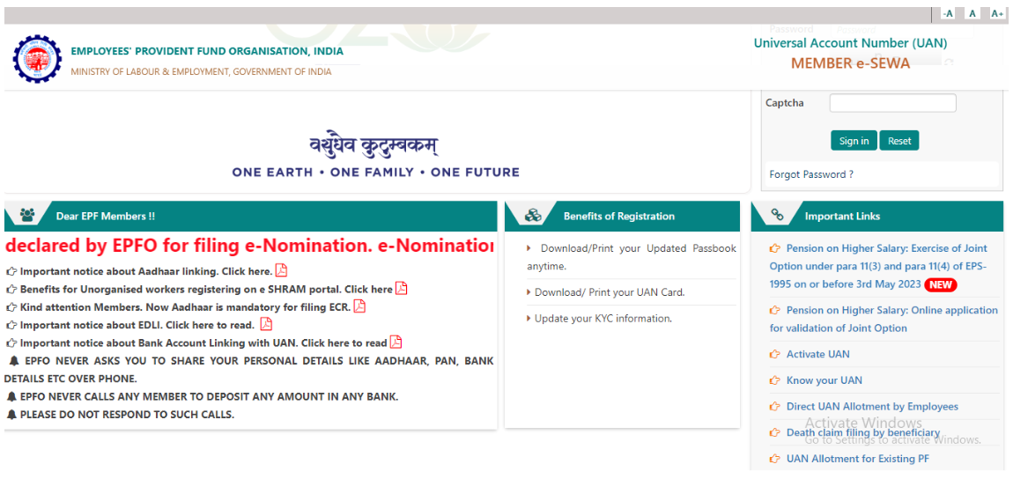
How to apply for a higher pension in EPF?
Below is the step to claim a higher pension amount for employees retired before 2014:
Step 1: Employees need to visit the EPFO Unified Member portal.
Step 2: Click on the ‘Pension on Higher Salary: Online application for validation of Joint Option’ option.

Slide 10
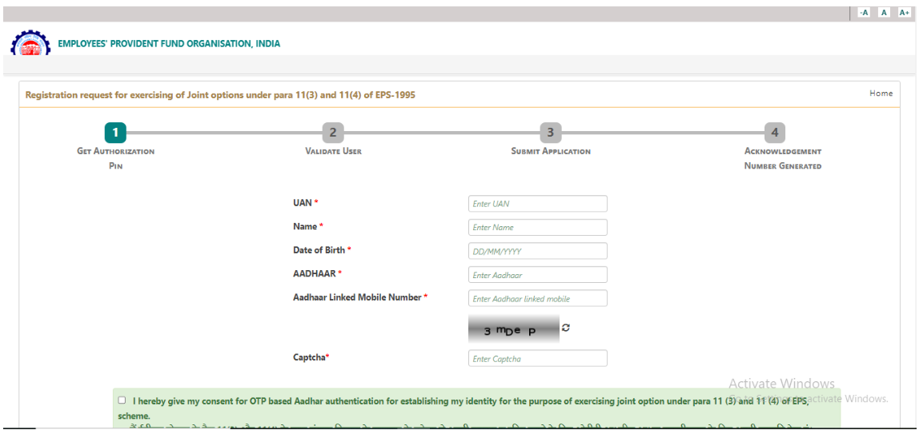
How to apply for a higher pension in EPF?
Step 3: Fill in the details and submit the form.
The EPFO will digitally register each application and provide the receipt number to the applicant. It will forward the applications to the respective employers, who will verify them through e-sign/digital signature for further processing. The APFC/RPFC-II will examine the case and send the higher pension decision to the applicants via email, post, phone or SMS.
The field officers will examine the application form. If the form is complete, the wage details submitted by the employers will be verified with the the field offices data. Where the field officers data and employers’ details match, the dues will be calculated and an order will be passed by RPFC-II/RPFC-I/APFC for depositing/transferring the dues. The cases where there is a mismatch, it will informed to the employer and the pensioner by the APFC/RPFC-II and one month time will be given to rectify the same.
In case the application form is not approved by the employer, an opportunity will be given to the employer to provide additional proof/evidence or correct any mistakes/errors before rejection of the form. Such opportunity will be given for a period of one month and under intimation to the pensioners.

Slide 11
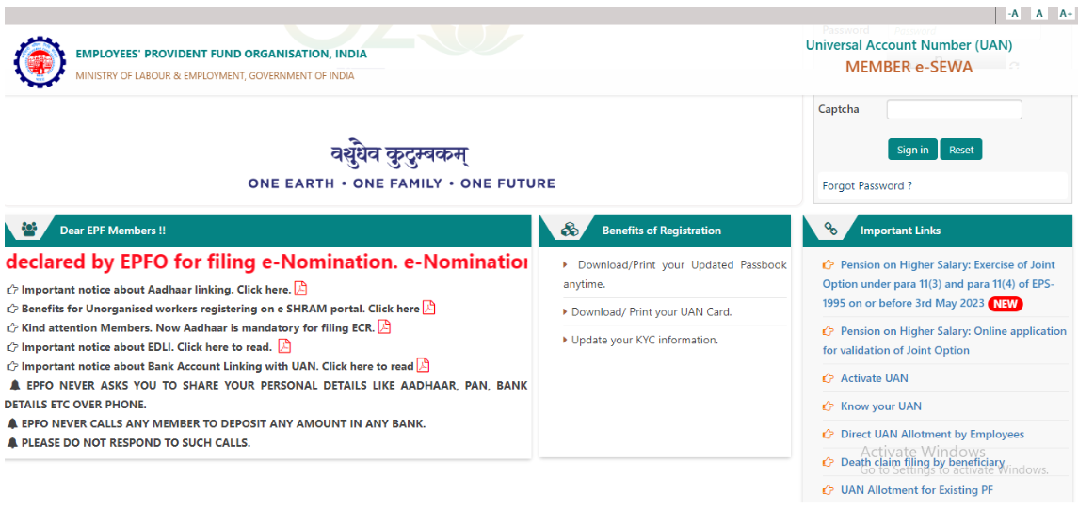
How to apply for a joint option online pension form in EPF?
Below is the step to exercise/apply for joint option under para 11(3) and para 11(4) of EPS-95 to claim for higher pension for employees who are part of EPS-95 but are working or retired after 2014:
Step 1: Employees need to visit the EPFO Unified Member portal.
Step 2: Click on the ‘Pension on Higher Salary: Exercise of Joint Option under para 11(3) and para 11(4) of EPS-1995 on or before 3rd May 2023’ option.

Slide 12
How to apply for a joint option online pension form in EPF?
Step 3: Fill in the details and submit the form.
The field officers will examine the joint option forms. If the form is complete, the wage details submitted by the employers will be verified with the the field offices data. Where the field officers data and employers’ details match, the dues will be calculated and an order will be passed by RPFC-II/RPFC-I/APFC for depositing/transferring the dues. The cases where there is a mismatch, it will informed to the employer and the employee by the APFC/RPFC-II and one month time will be given to rectify the same.
In case the join option is not approved by the employer, an opportunity will be given to the employer to provide additional proof/evidence or correct any mistakes/errors before rejection of the form. Such opportunity will be given for a period of one month and under intimation to the employees.

Slide 13
EPFO guidelines for higher pension
  The joint option/higher pension claim application should contain a disclaimer or declaration.
  An employee should give explicit consent in the joint option/application form for a share adjustment from PF to EPS and a re-deposit of the amount.
  An employee should give an undertaking of the trustee for a share transfer of funds from exempted PF trust to the EPFO pension fund. The undertaking will be effective for the deposit of due contribution and interest up to the payment date within the specified time.
  The employer’s contribution share refund will be deposited with the interest rate declared under para 60 of the EPF Scheme, 1952, for employees of unexempted establishments.
  The following documents should be submitted with the higher pension claim application:
    Proof of joint option verified by the employer filed under para 26(6) of the EPF scheme.
    Proof of joint option verified by the employer filed under para 11(3) provision.
    Proof of remittance of EPS contribution in the PF account exceeding the current wage limit of Rs.6,500 or Rs.5,000.
    Written refusal of APFC or EPFO to such remittance or request.
  The following documents should be submitted with the joint option application:
    Proof of remittance of EPS contribution in the PF account exceeding the current wage limit of Rs.6,500 or Rs.5,000.
    Proof of joint option verified by the employer filed under para 26(6) of the EPF scheme.
  The EPFO will issue further circulars regarding the deposit method and pension computation.
  An employee can raise a complaint on EPFiGMS when they face a grievance to get a higher pension after submitting the application and payment of the due contribution if any.

Slide 14
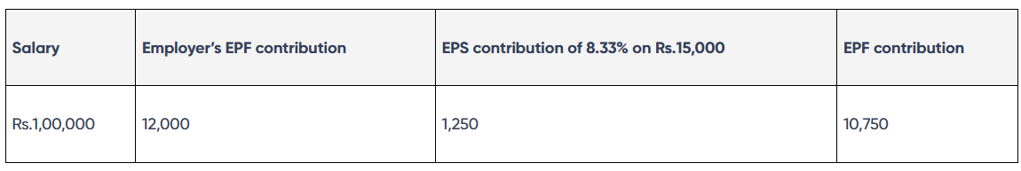
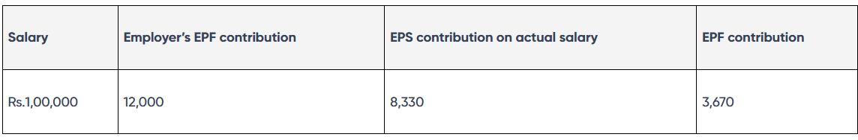
EPF higher pension calculation
The current monthly EPS calculation on the cap of Rs.15,000 is provided below:
Whereas, the monthly EPS calculation on the actual salary is as follows:
8330
( up to 31-08-2014)
9490
(01-09-2014 onwards)
Thus, you will get more monthly EPS contribution when you file a joint option since it is contributed on your actual salary. When you apply for a higher pension, the extra amount, i.e. 7,080/8240 (1,250-8,330/9490), will be transferred from the employee’s EPF to EPS for the entire service period (i.e., date of joining the employment till the retirement date).

Slide 15
Frequently Asked Questions
How to get a higher pension from EPFO?
Eligible employees should submit the joint claim or higher pension claim application to the concerned regional PF commissioners to get a higher pension.
How to opt for a higher pension in EPFO?
Eligible Employees who are members of the EPS-95 and are in service/retired after 01/09/2014 can opt for a higher pension by filing a joint option application enabled in member login and submit it before 26/06/2023.
Is the higher pension scheme beneficial?
It benefits individuals who want a higher monthly pension but do not require a huge lump sum upon retirement. The higher pension contribution will increase the monthly pension amount but reduce the EPF lump sum given to an employee upon retirement. Thus, individuals who have other investments and will receive a lump sum upon its maturity can opt for the higher pension scheme. However, the monthly pension is taxable, but the lumpsum EPF amount given after retirement is tax-exempt.
The method of calculation and quantum of pension will be communicated in due course to the members on receipt of SOP from head office.

Slide 16



THANK'S FOR WATCHING
RO RR NAGAR, BANGALORE

